Slide 1
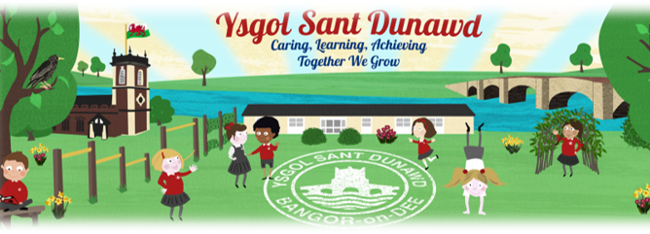
Welcome to Dosbarth Alyn

Slide 2
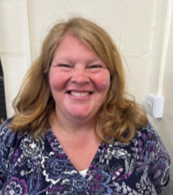
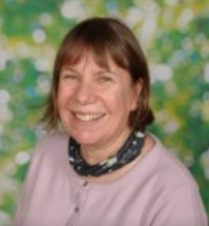
MEET THE CLASS TEACHERS…
Mrs Johnson Mrs Walker

Slide 3
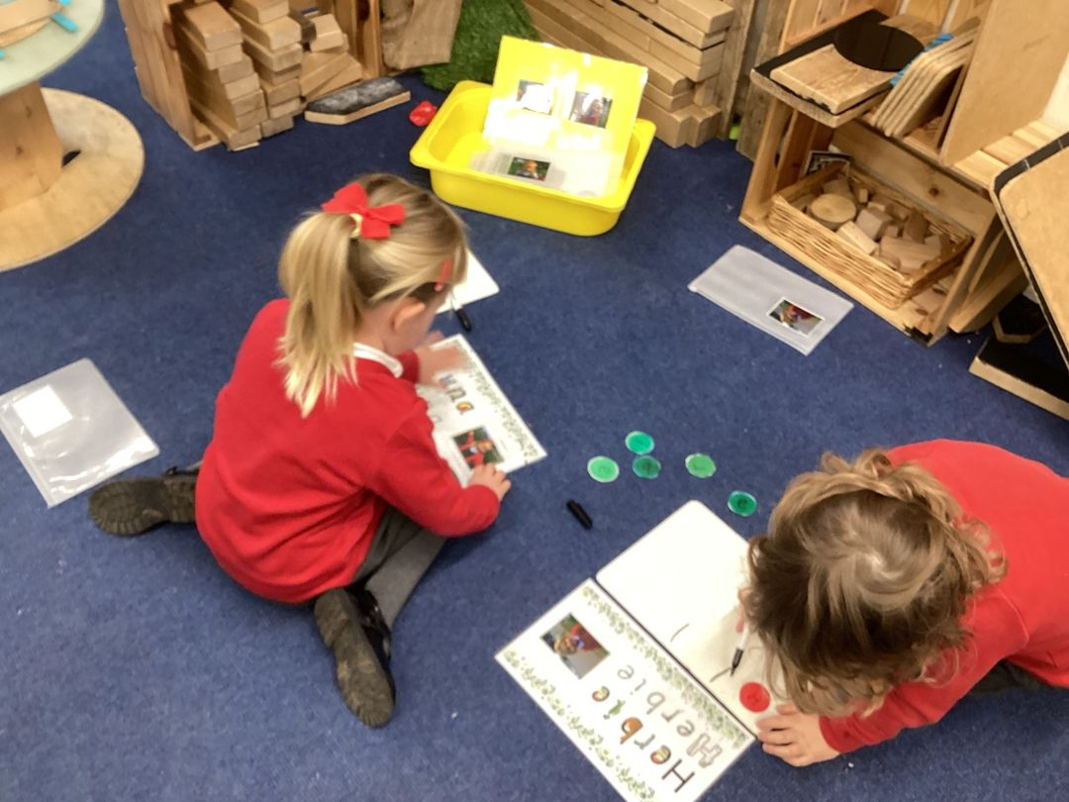
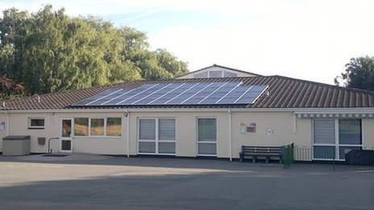
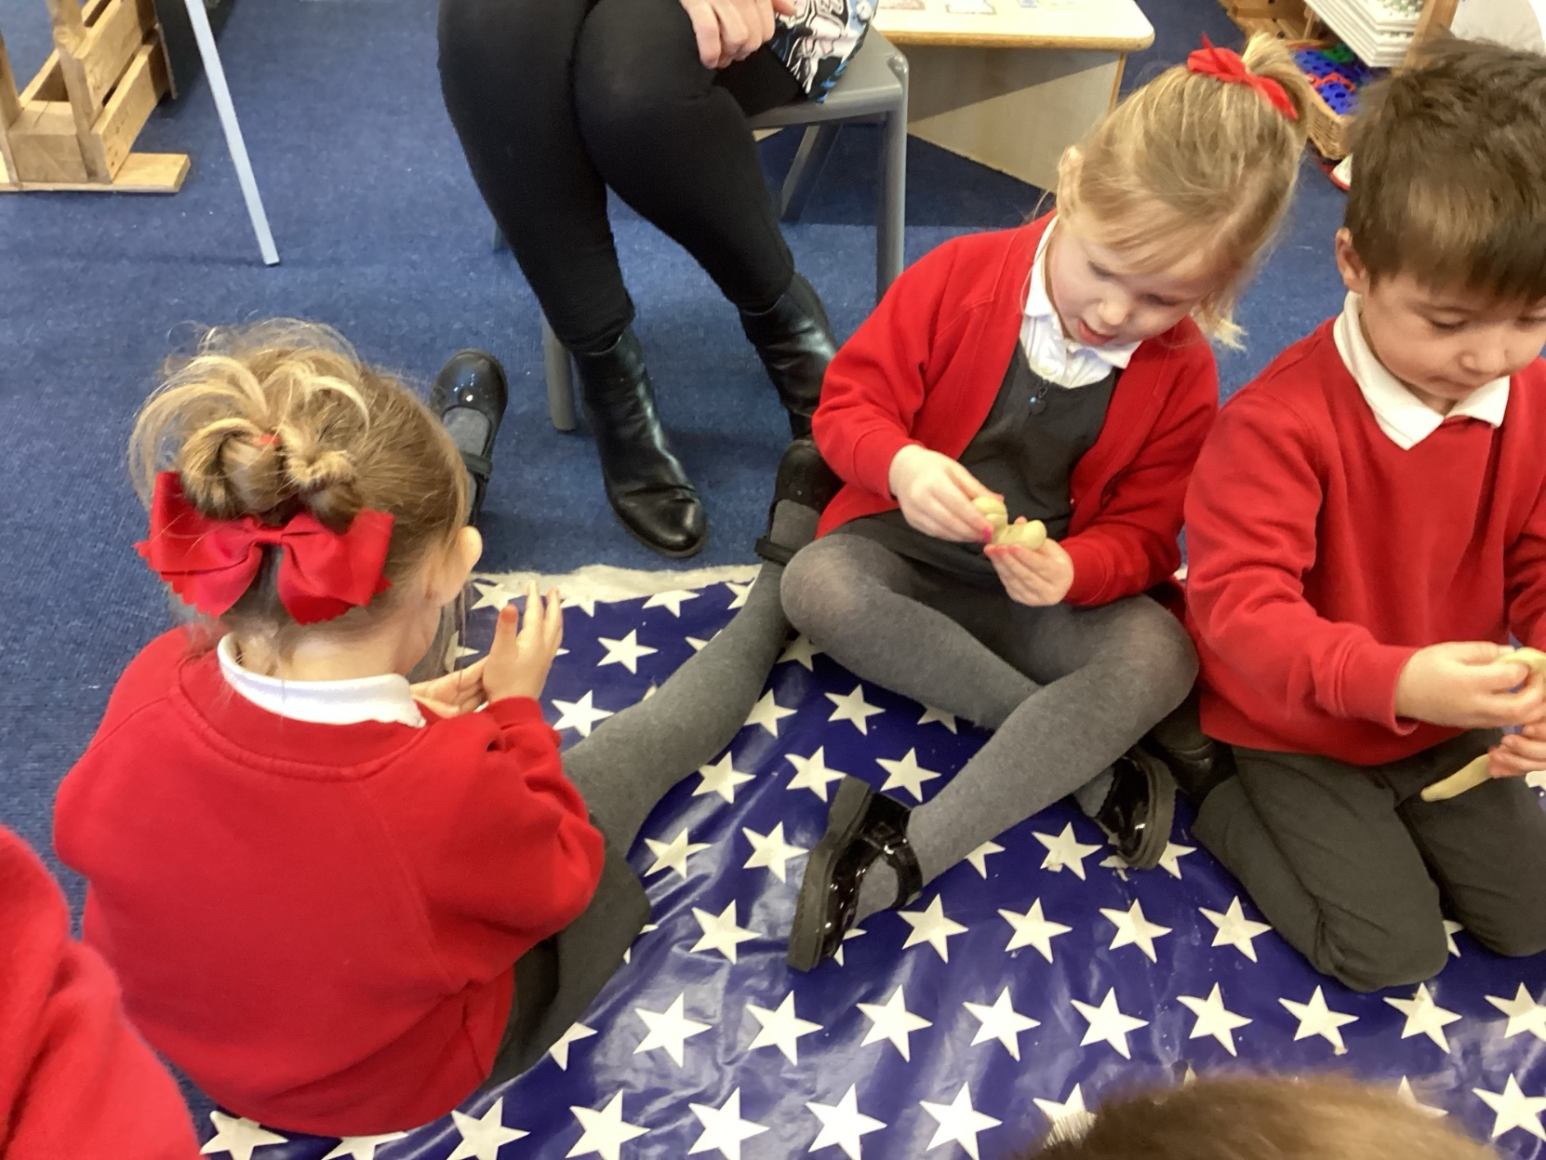
OUR SCHOOL DAY.
School starts at 8.55am and will finish at 11.25am, for the first few weeks we will meet the children at the gate each morning and escort them into class.
If you require childcare before 8.55 or after 11.25 please contact Bangor on Dee Childcare to arrange

Slide 4
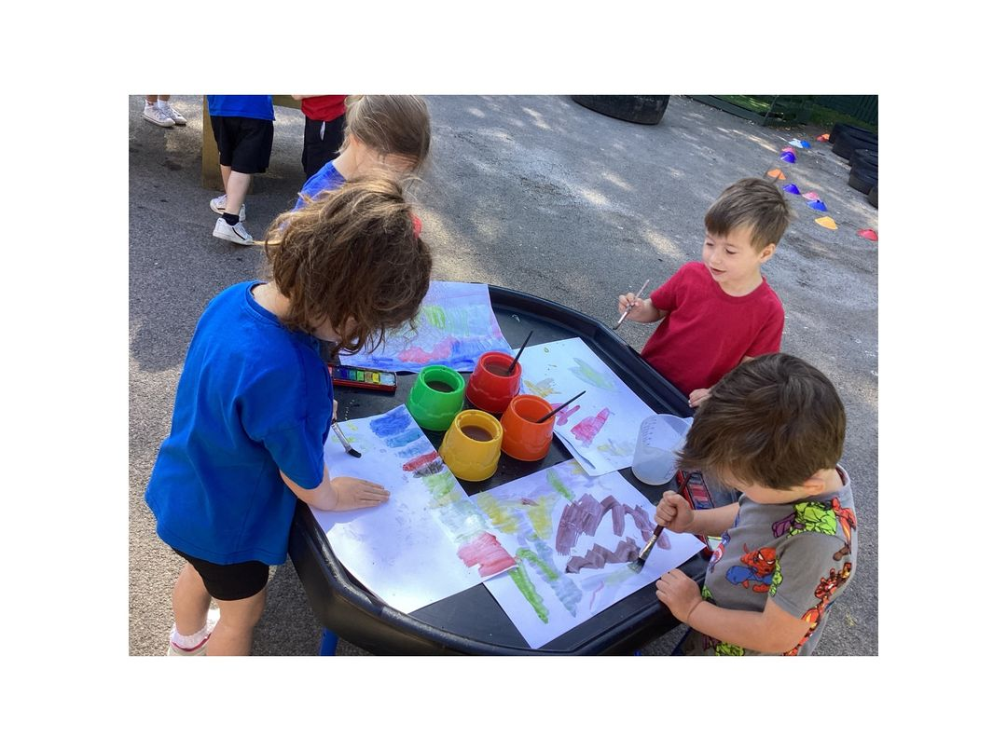
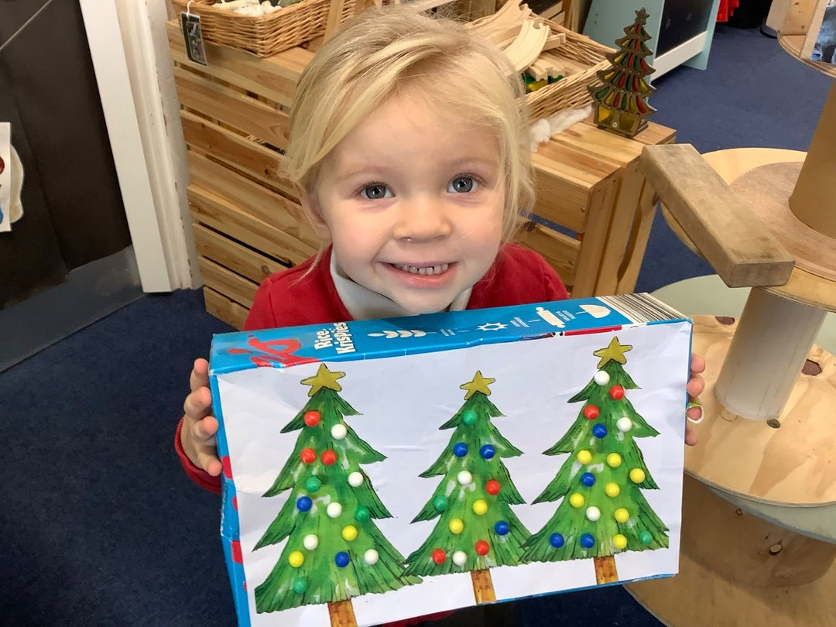
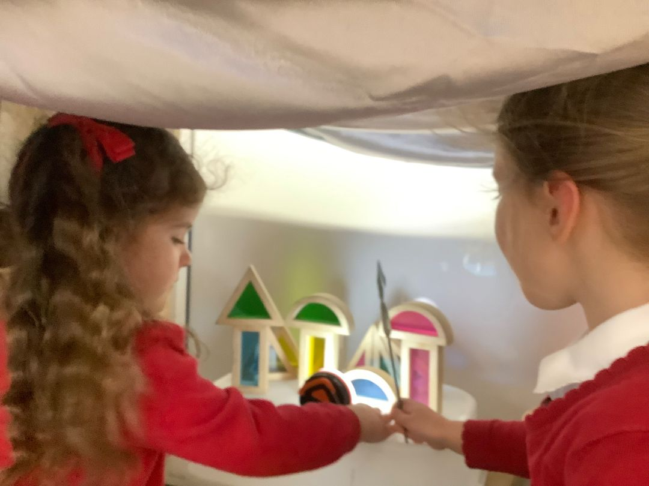
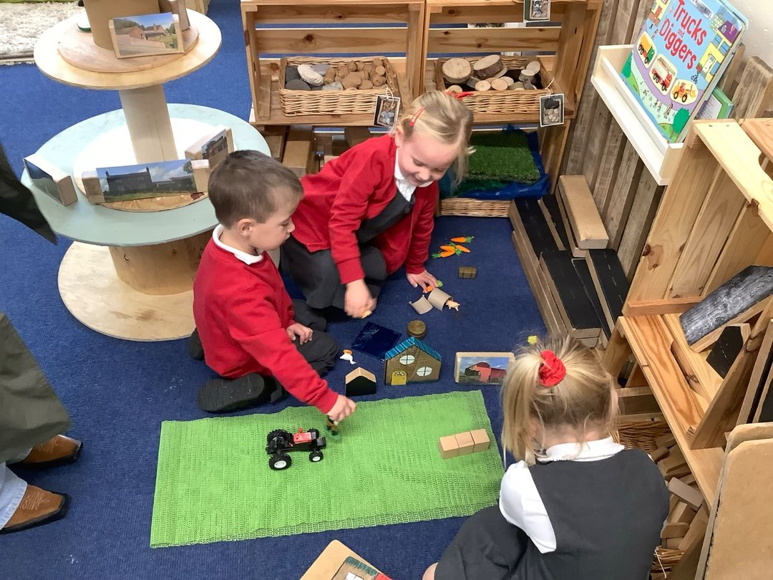
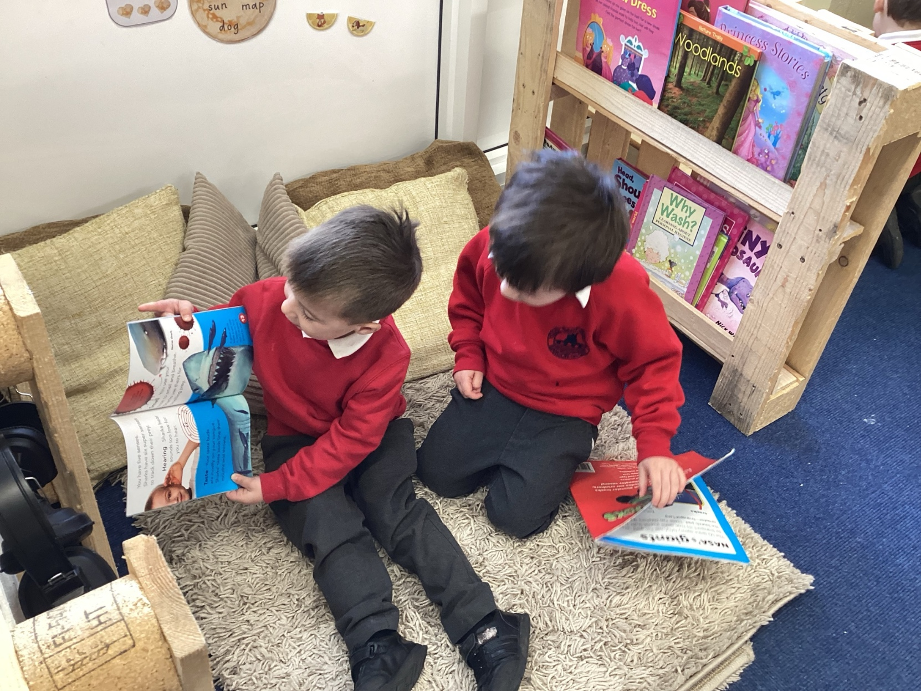
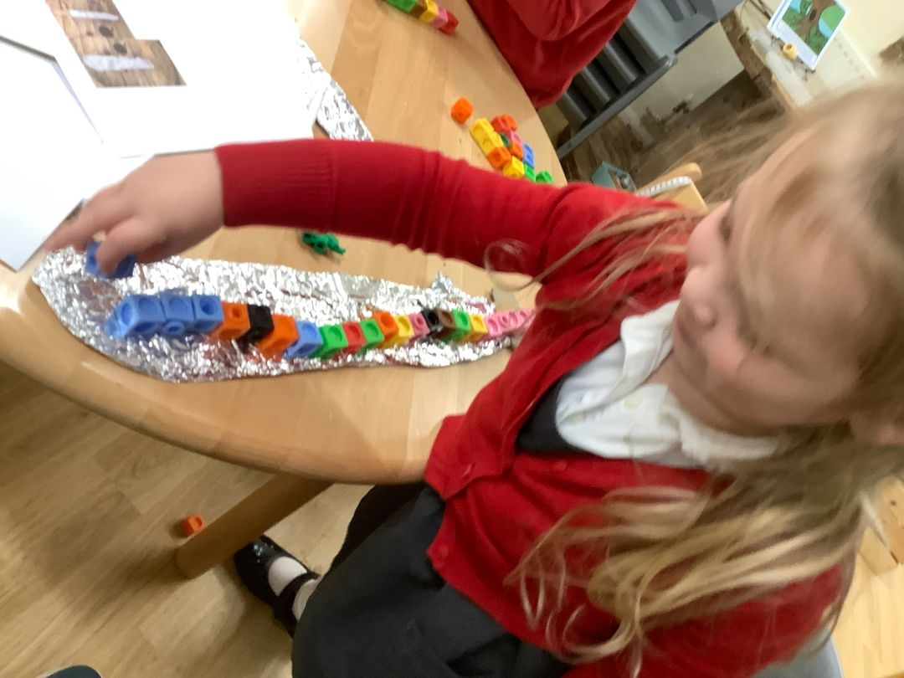
During the morning we have a mixture of group time activities and play based learning. We sing lots of songs and rhymes and will always share a storybook.

Slide 5
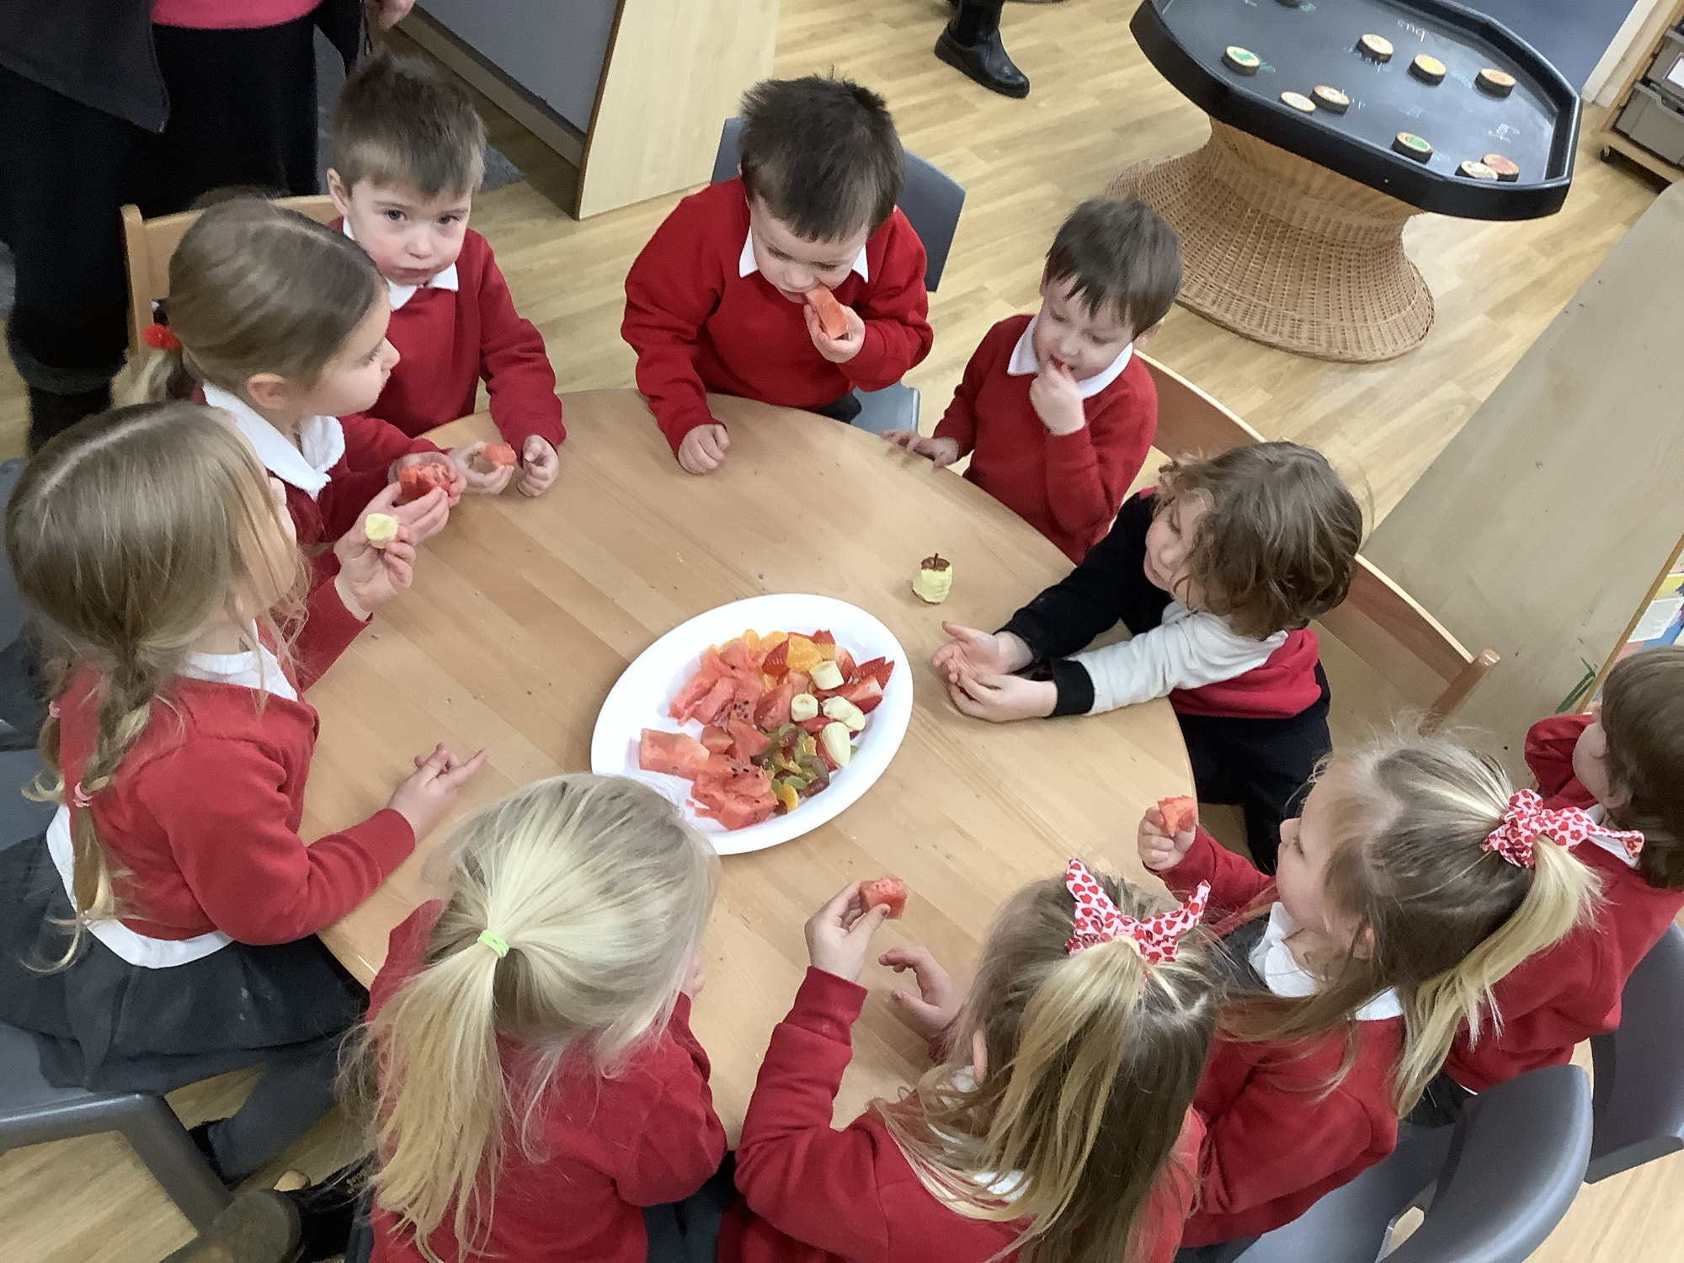
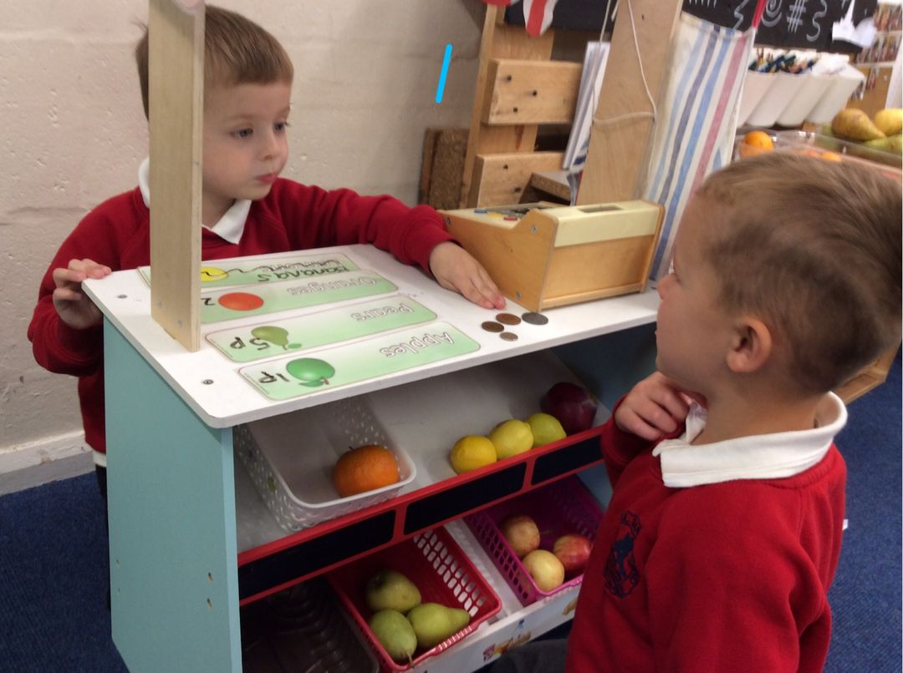
Snack
During the morning the children will be able to have a fruit snack and drink. School can provide a snack at a cost of £1.50 a week and milk is free. Children are encouraged to also bring in a water bottle to have access to water throughout the morning but we do ask that there is no juice/squash as part of our healthy schools policy. Signing up to snack will be sent out within the first week.

Slide 6
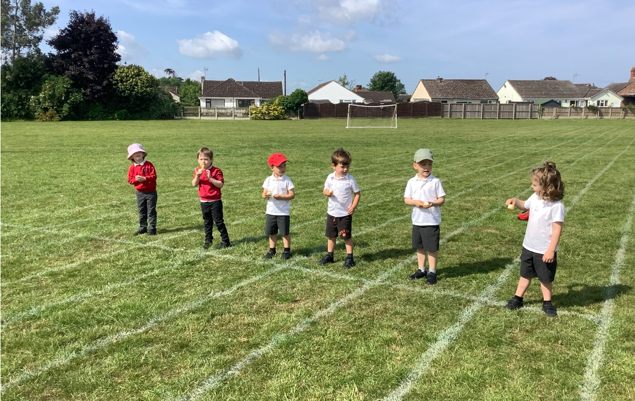
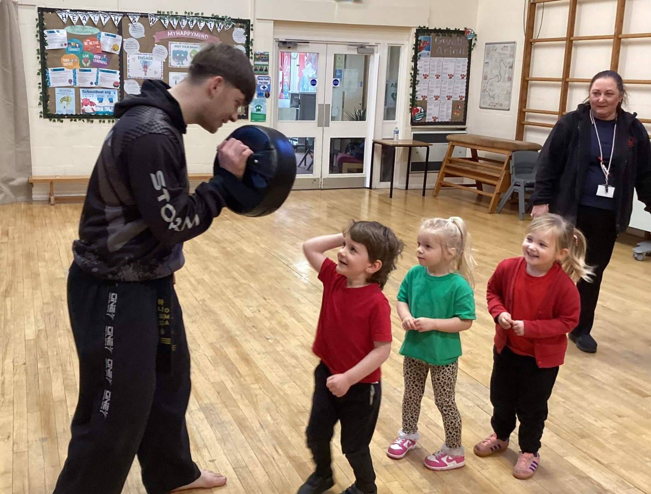
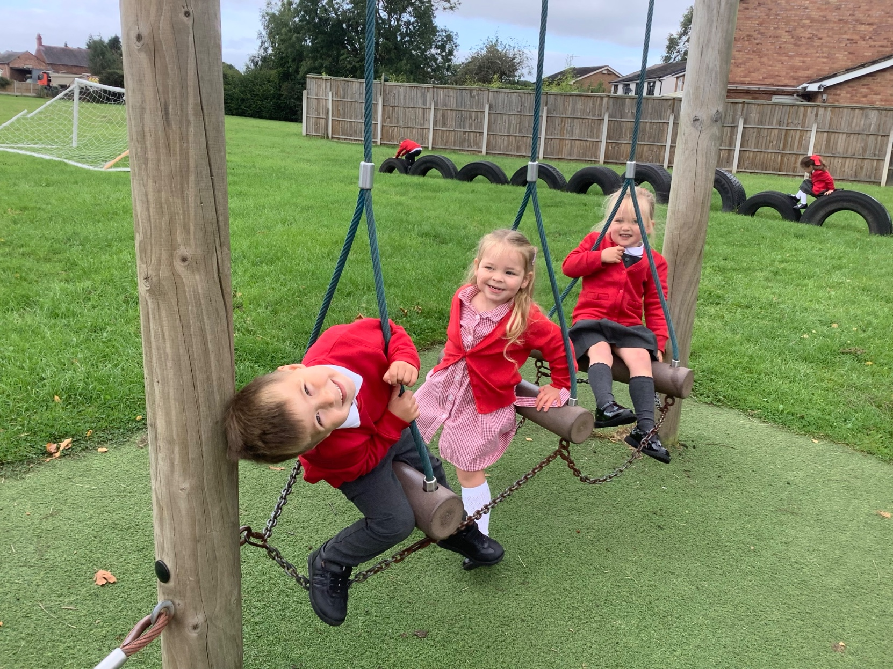
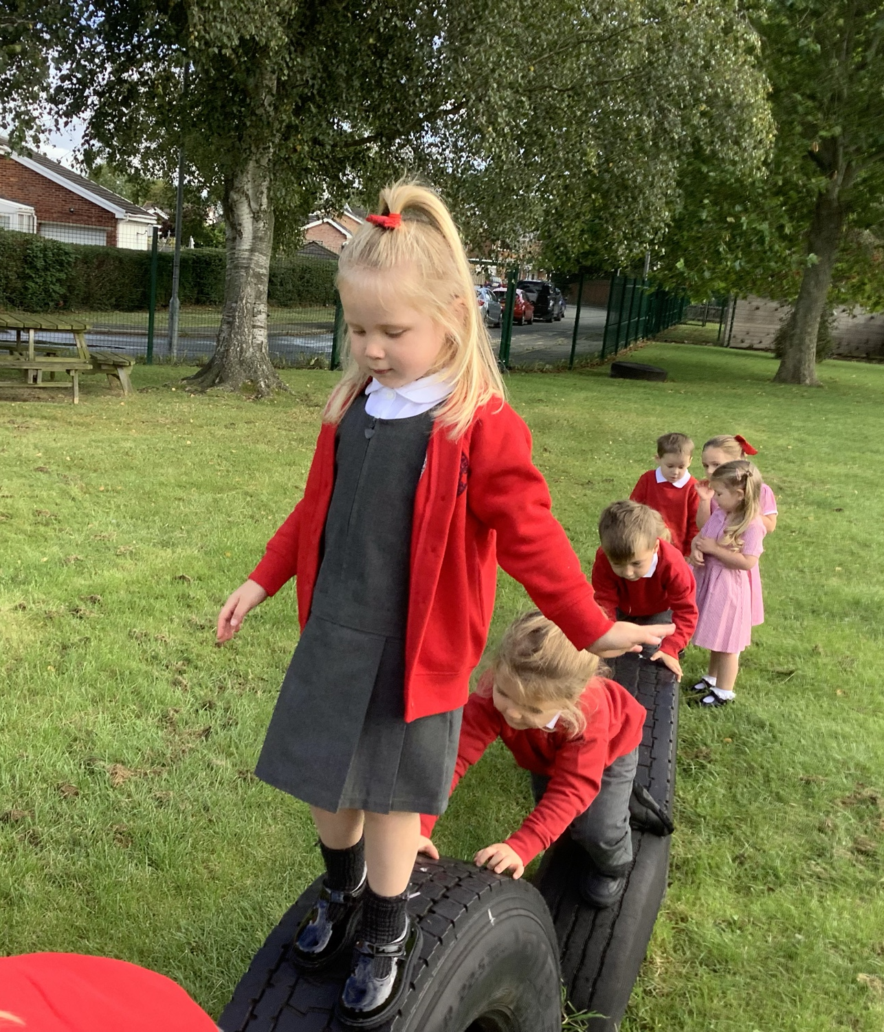
Physical Exercise
As we are very movement and physical based the children are always very active however we do have a PE session to introduce the children to new skills every other week. On these days the children will be required to come to school ready in their PE kits:
PE kit
Plain white t-shirt or house colour t-shirt (red, green or blue) • Plain black shorts • Plain black pumps/ trainers • During the winter months, children may bring a plain black tracksuit.

Slide 7
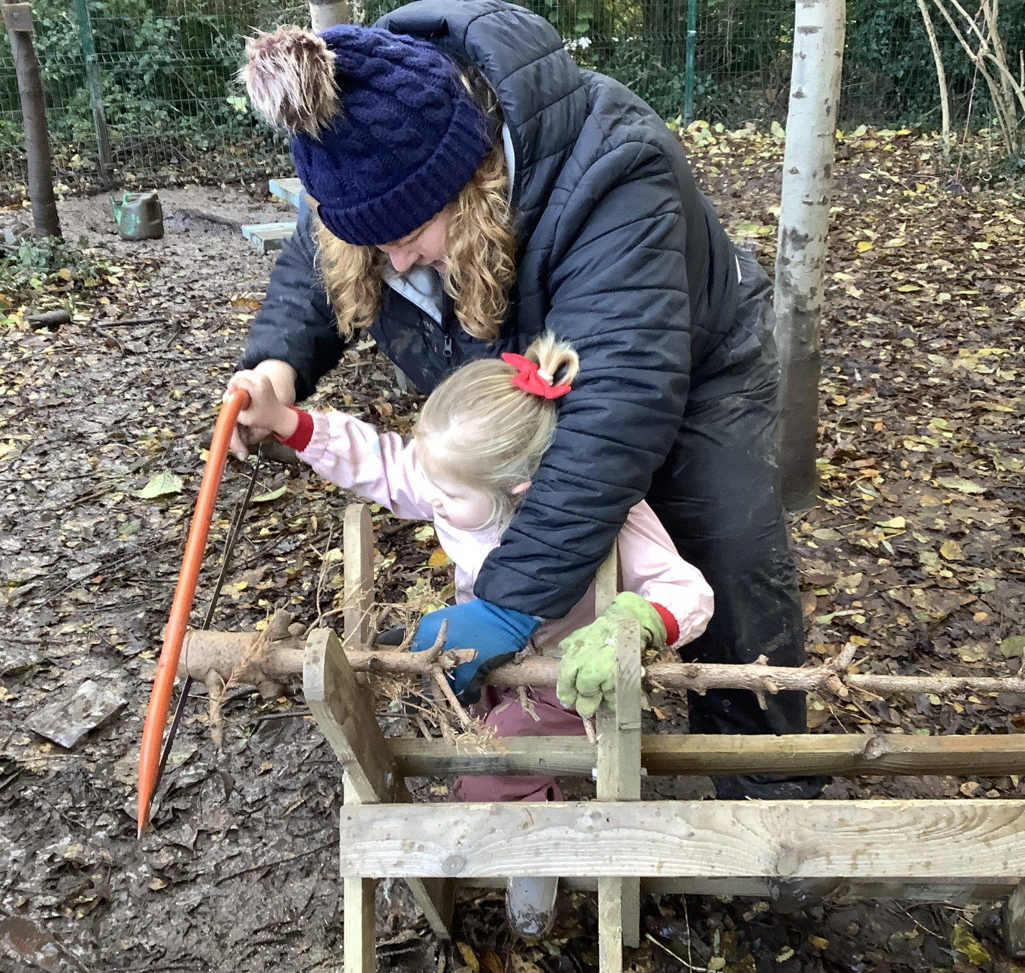
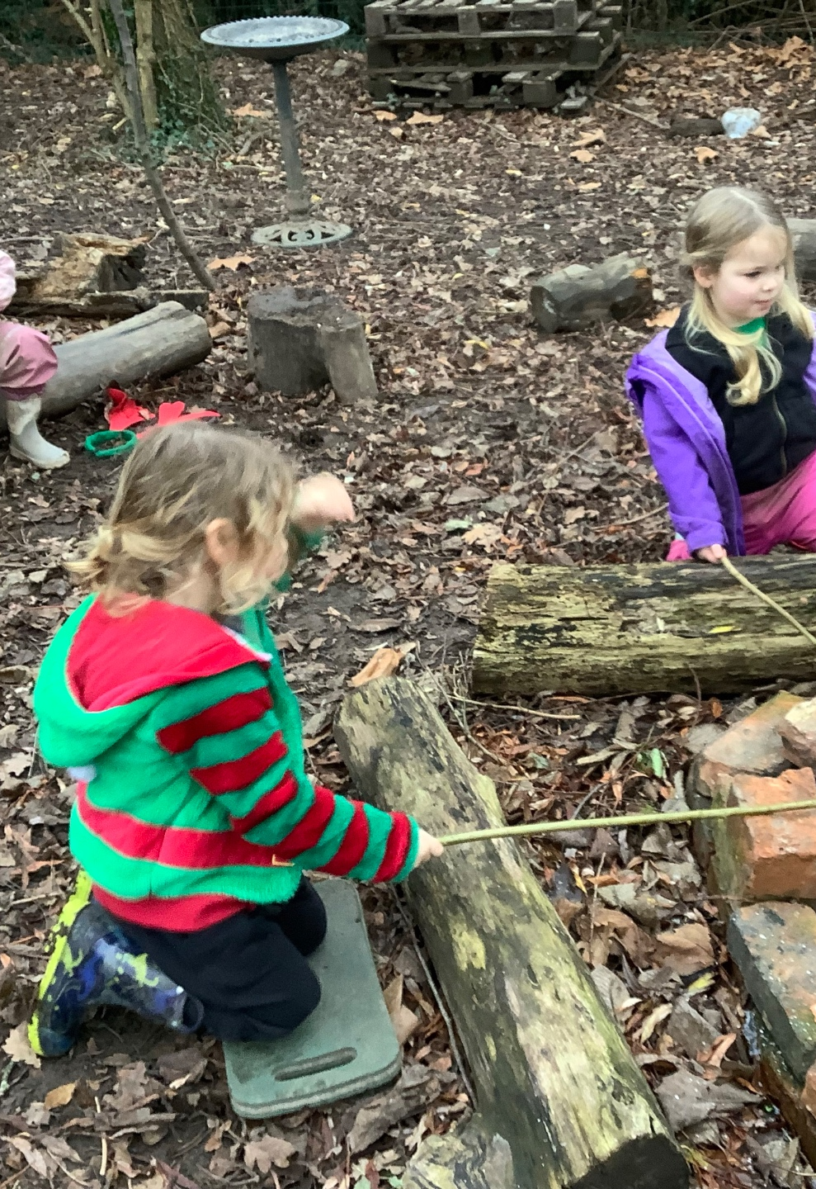
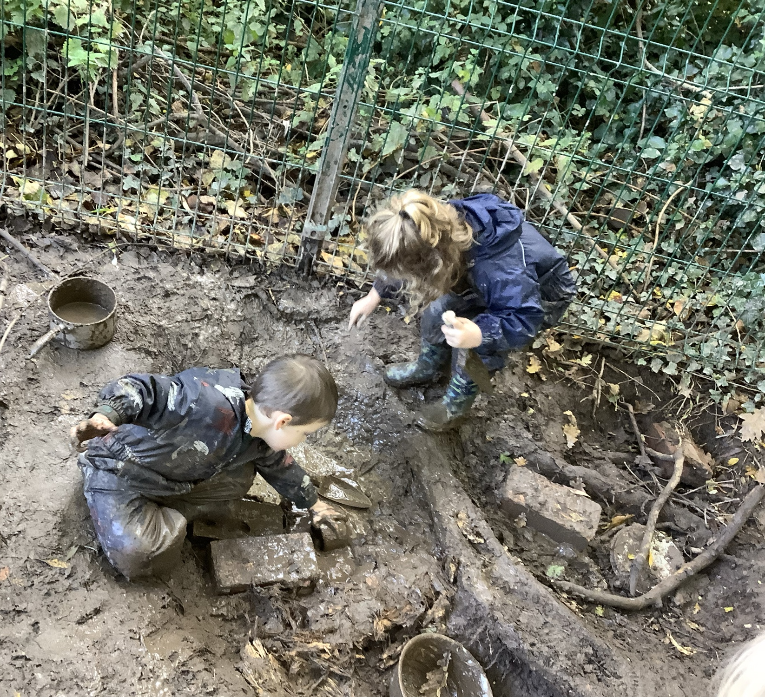
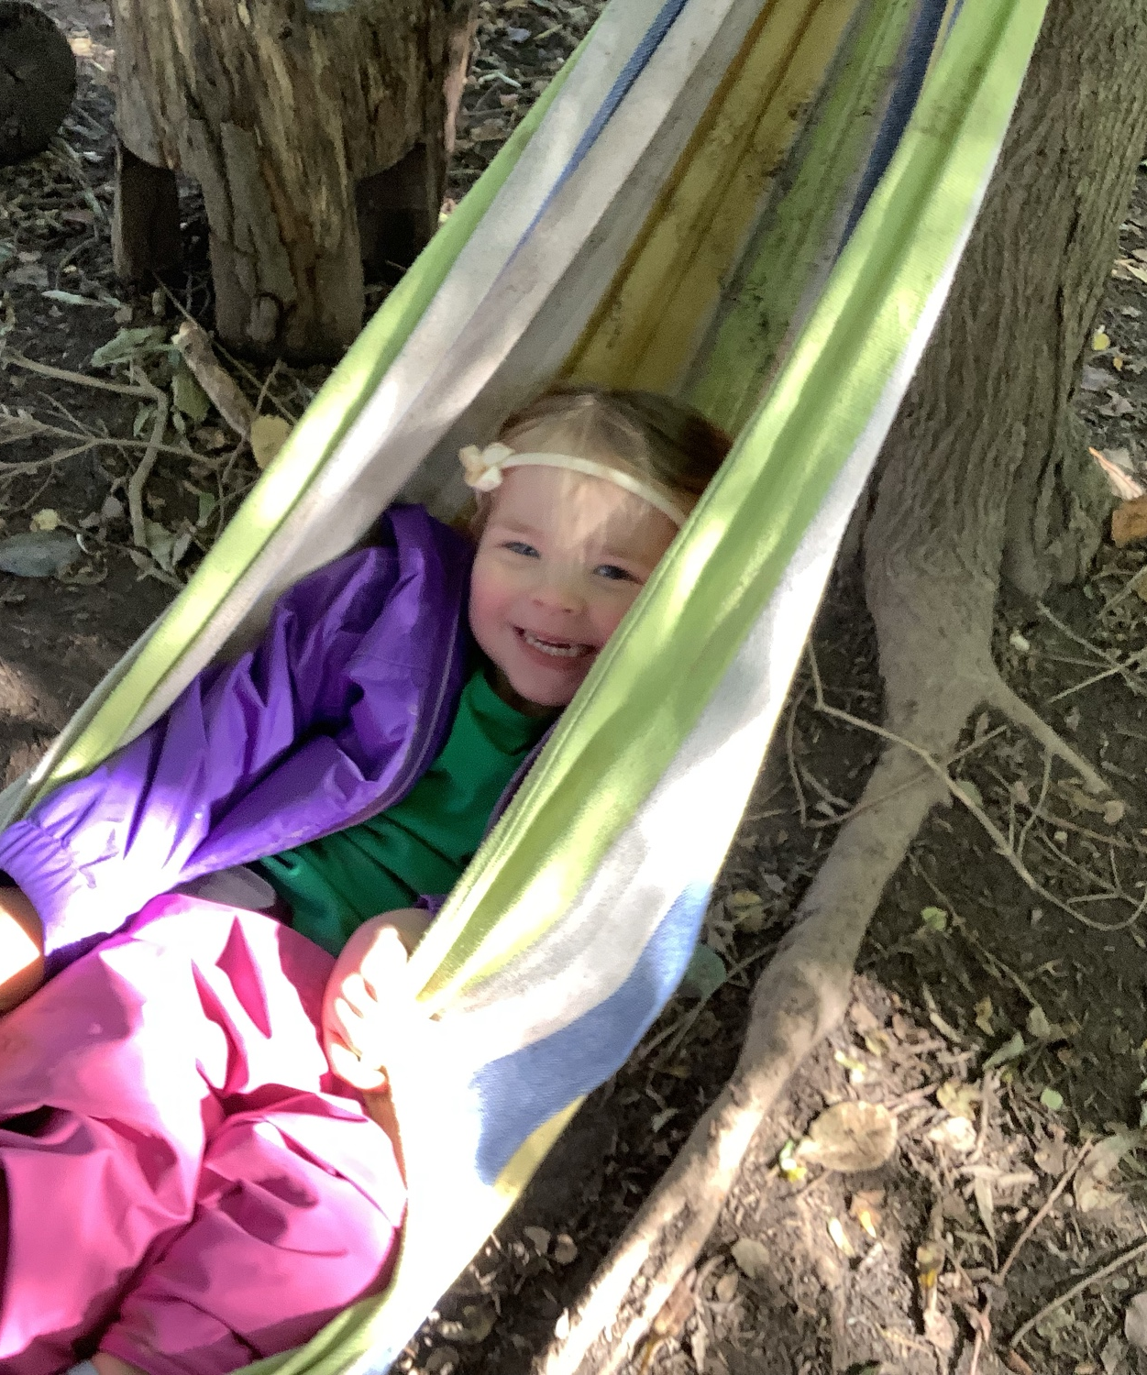
Forest School
We alternate Forest School and PE each week as they are both very physical based sessions. The children will require suitable clothing including a waterproof coat and trousers as well as wellies. We ask that these are left in school as we can then use these during wet weather and in the water areas throughout the week.

Slide 8





SANT DUNAWD’S SUPER LEARNING POWERS.

Slide 9
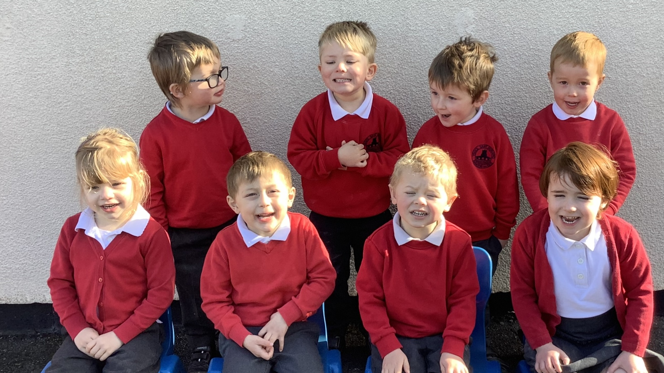
SCHOOL UNIFORM.
Full information about our school uniform can be found on the attached link, I would like to add to this waterproof /all in one / trousers and a pair of wellies which can remain in school please. https://santdunawd.co.uk/school-uniform/

Slide 10
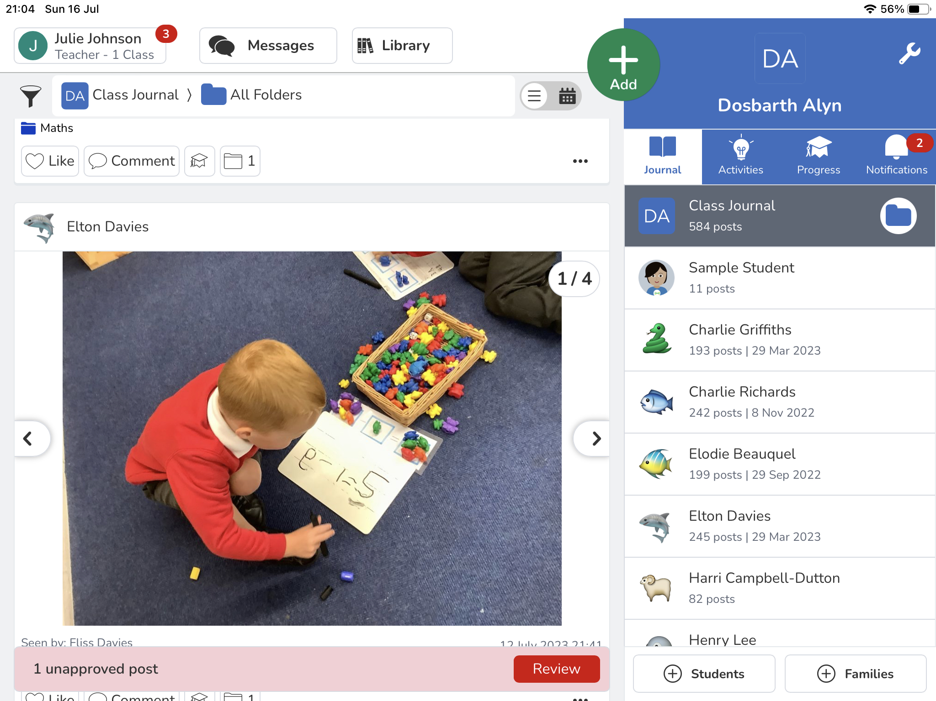

SEESAW IS AN APP WHICH WE USED THROUGHOUT THE SCHOOL TO COMMUNICATE, SHARE AND FEEDBACK WITH YOURSELVES WITH ALL LETTERS AND IMAGES OF WHAT YOUR CHILDREN HAVE BEEN UP TO THROUGHOUT THE DAY.

Slide 11
PREPARATION FOR SEPTEMBER.
Encourage independence, putting their own coat on, carrying their belongings and personal hygiene.
Label everything with your child's name, clothes, coats, lunchboxes, shoes, water bottles with names.
Toileting, we do have a toileting policy and support all children with toilet training. If you have any concerns or questions please get in contact.
Change of clothes. we do have a limited amount of spare uniform if your child needs changing for whatever reason during the morning, however we welcome you to send in spares if you prefer.
Ensure school are aware of any medical and dietary requirements and any up to date medication eg inhalers are provided to the class teacher.
Please keep us up to date with any changes to your contact details either email or call into the school reception to inform us.
If your child / children are being picked up by someone who does not collect your child on a regular basis, please send me a message via seesaw to ensure home time runs smoothly.
We try to go outside as much as possible in all weathers for both learning and play. So please make sure your child has a coat in school everyday.

Slide 12
Contact details
School email address ; Mailbox@santdunawd-pri.wrexham.sch.uk
Bangor on Dee Childcare info@bangorondeechildcare.co.uk
Mrs Johnson via Seesaw
If you have any further questions or concerns please do not hesitate to contact us.
https://www.youtube.com/watch?v=ecaB-krq7NM
Nursery education for 3 and 4 year olds: A guide for parents and carers

